Slide 1
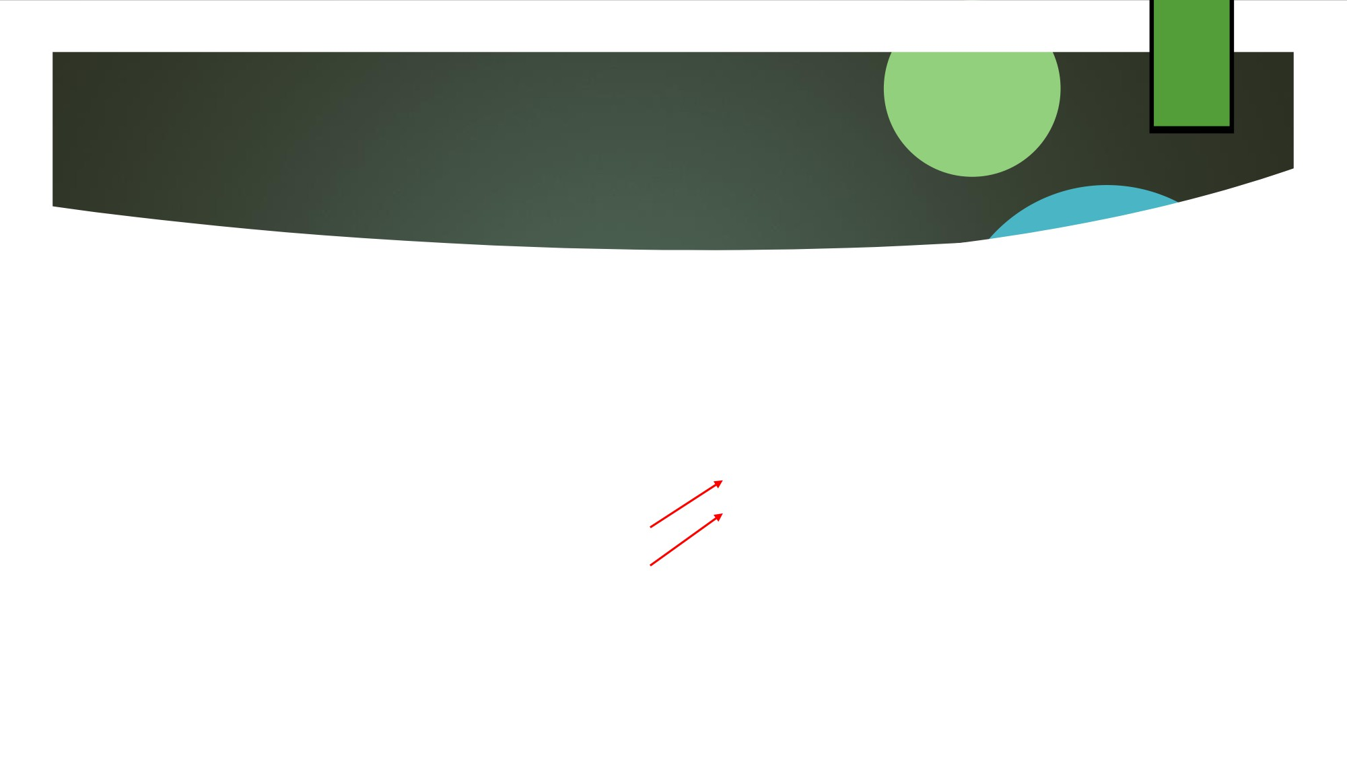
2
3.2 Basic Compiler Techniques for Exposing ILP
◆
Consider the following statements:
a = b + c; d = e - f;
◆
Slow code:
lw $10,0($1)
To avoid a pipeline stall, the execution of a dependent instruction
lw $10, ($1) # $1 = addr b
lw $11, 0($2)
lw $11, ($2) # $2 = addr c
add $12, $10, $11 # Dependence
lw $13,0($4)
must be separated from
sw $12, ($3) # $3 = addr a
lw $14,0($5) add$12, $10, $11
the source instruction by a distance in clock cycles equal to the pipeline latency of that source
lw $13, ($4) # $4 = addr e
lw $14, ($5) # $5 = addr f
sub $15, $13, $14 # Dependence
sw $12,0($3)
sw $15, ($6) # $6 = addr d
sub $15, $13, $14 sw $14, 0($6)
instruction.

Slide 2

3
for (i=999; i>=0; i=i-1)
x[i] = x[i] + s;
◆ Each iteration is independent; adding a scalar to a vector
Loop: L.D F0,0(R1)
;F0=array element
ADD F4,F0,F2
;add scalar from F2
SD F4,0(R1)
;store result ;decrement ptr 8B ;branch R1!=R2
DADDUI R1,R1,#-8 BNE R1,R2,Loop

Slide 3
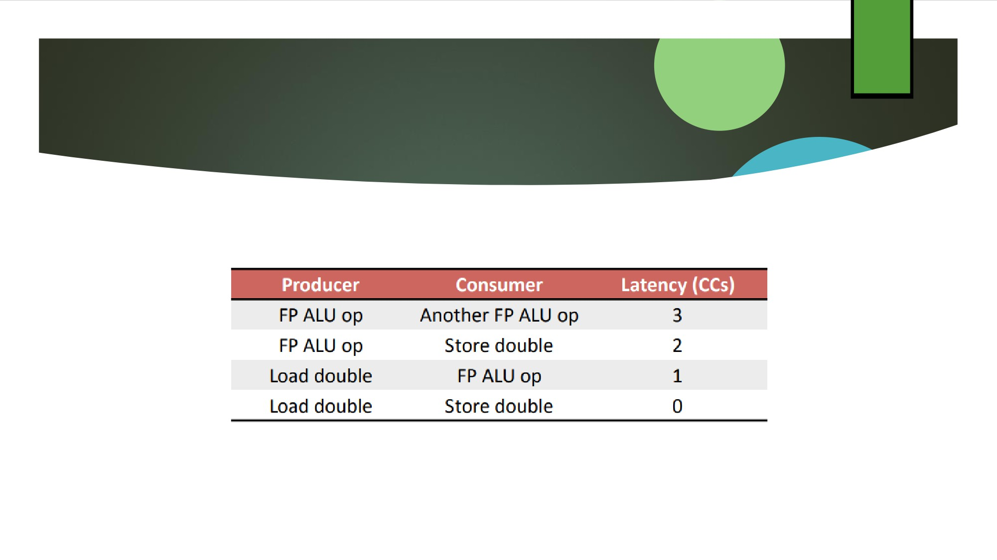
4
◆
Assume the following FP latencies (averages):

Slide 4
5
Loop Example: Unscheduled Code
1. Loop: L.D F0,0(R1)
2. stall
;load interlock
3. ADD.D F4,F0,F2
4. stall
;data hazard (F4) ;data hazard (F4)
5. stall
6. S.D F4,0(R1)
7. DADDUI R1,R1,#-8
8. stall
;branch interlock
9. BNE R1,R2,Loop

Slide 5
6
Loop Example: Scheduled Code
1. Loop: L.D F0,0(R1)
2. DADDUI R1,R1,#-8
3. ADD.D F4,F0,F2
4. stall
;data hazard (F4)
5. stall
;data hazard (F4)
6. S.D F4,8(R1) ;0+8 = 8
7. BNE R1,R2,Loop
◆ Still the actual work of operating on the array element takes just three (the load, add, and store) of those seven clock cycles.
◆ The remaining four clock cycles consist of loop overhead—the DADDUI and BNE—and two stalls.

Slide 6
7
Loop Unrolling
◆ Unroll the loop
◆ Replicate the body of the loop many times  Adjust the loop termination code
◆ Eliminating the branch allows instructions from different iterations to be scheduled together.
◆ In this case we can eliminate the data stall
◆ We also increase the ratio of useful work to overhead  Doing so requires more registers

Slide 7
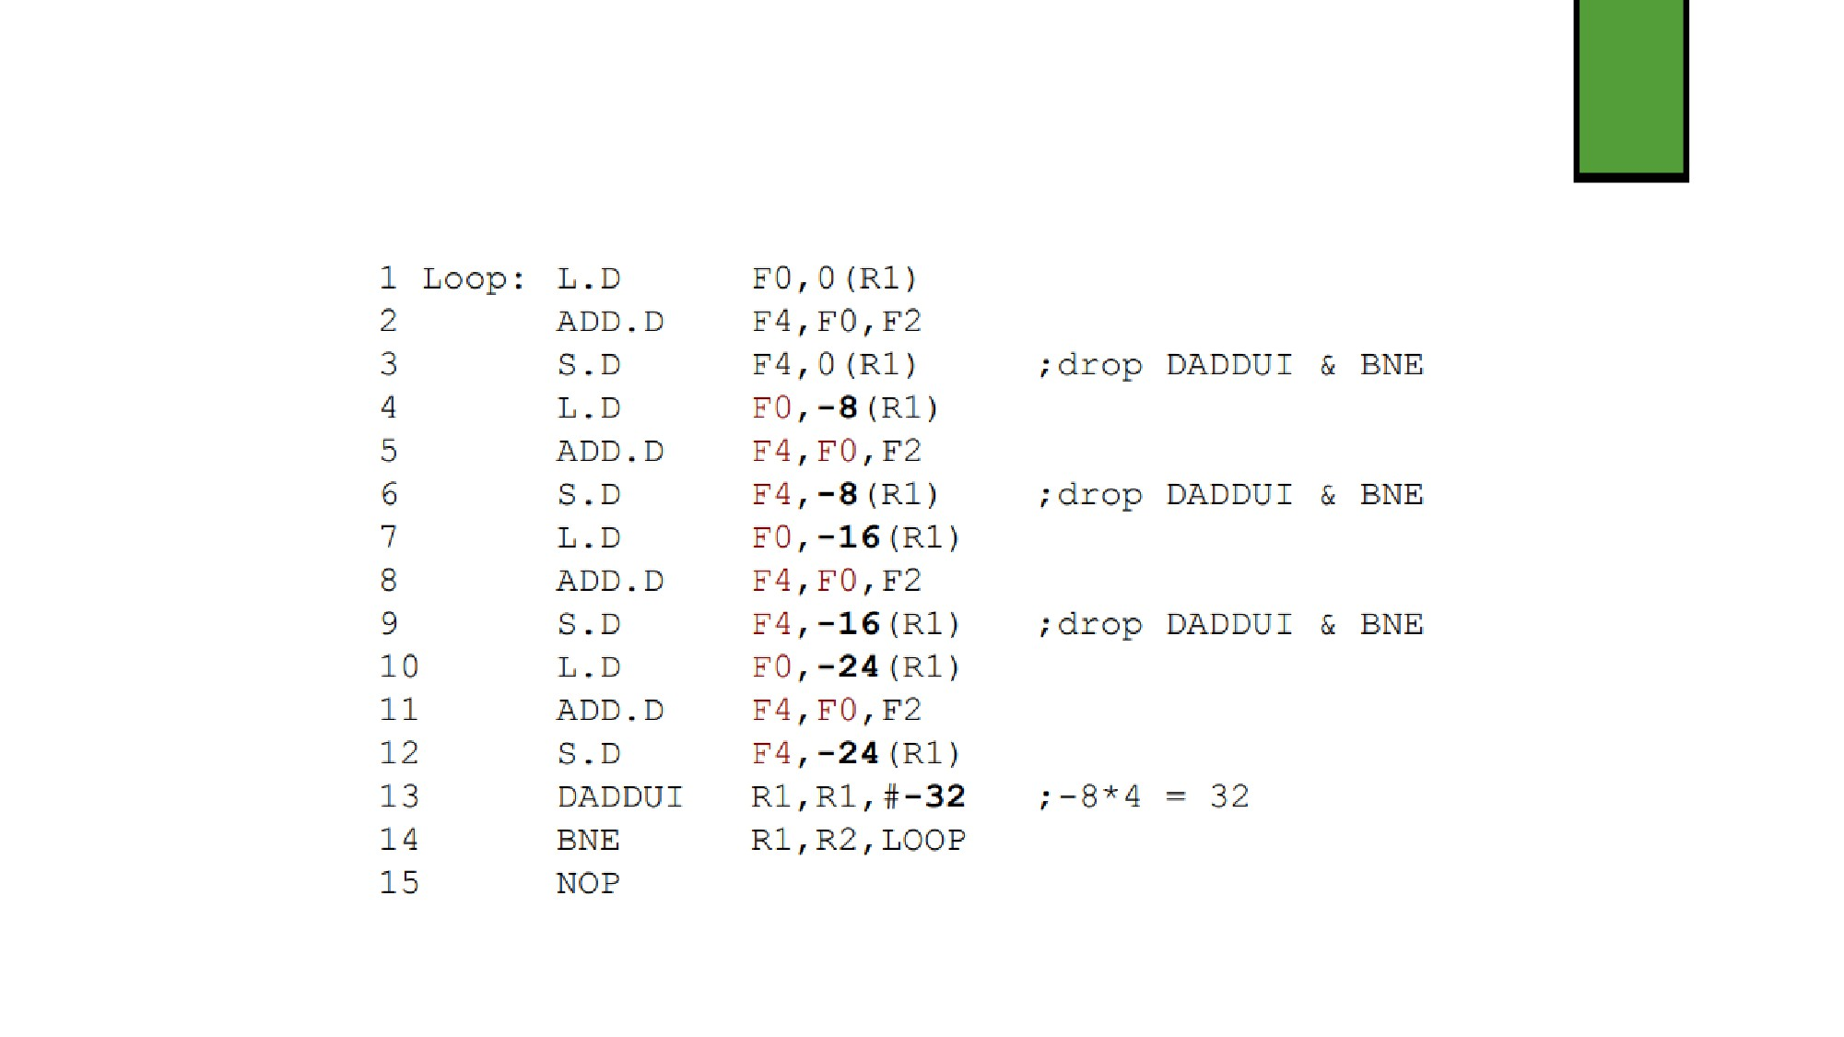
First Step: Copy the Loop
8

Slide 8
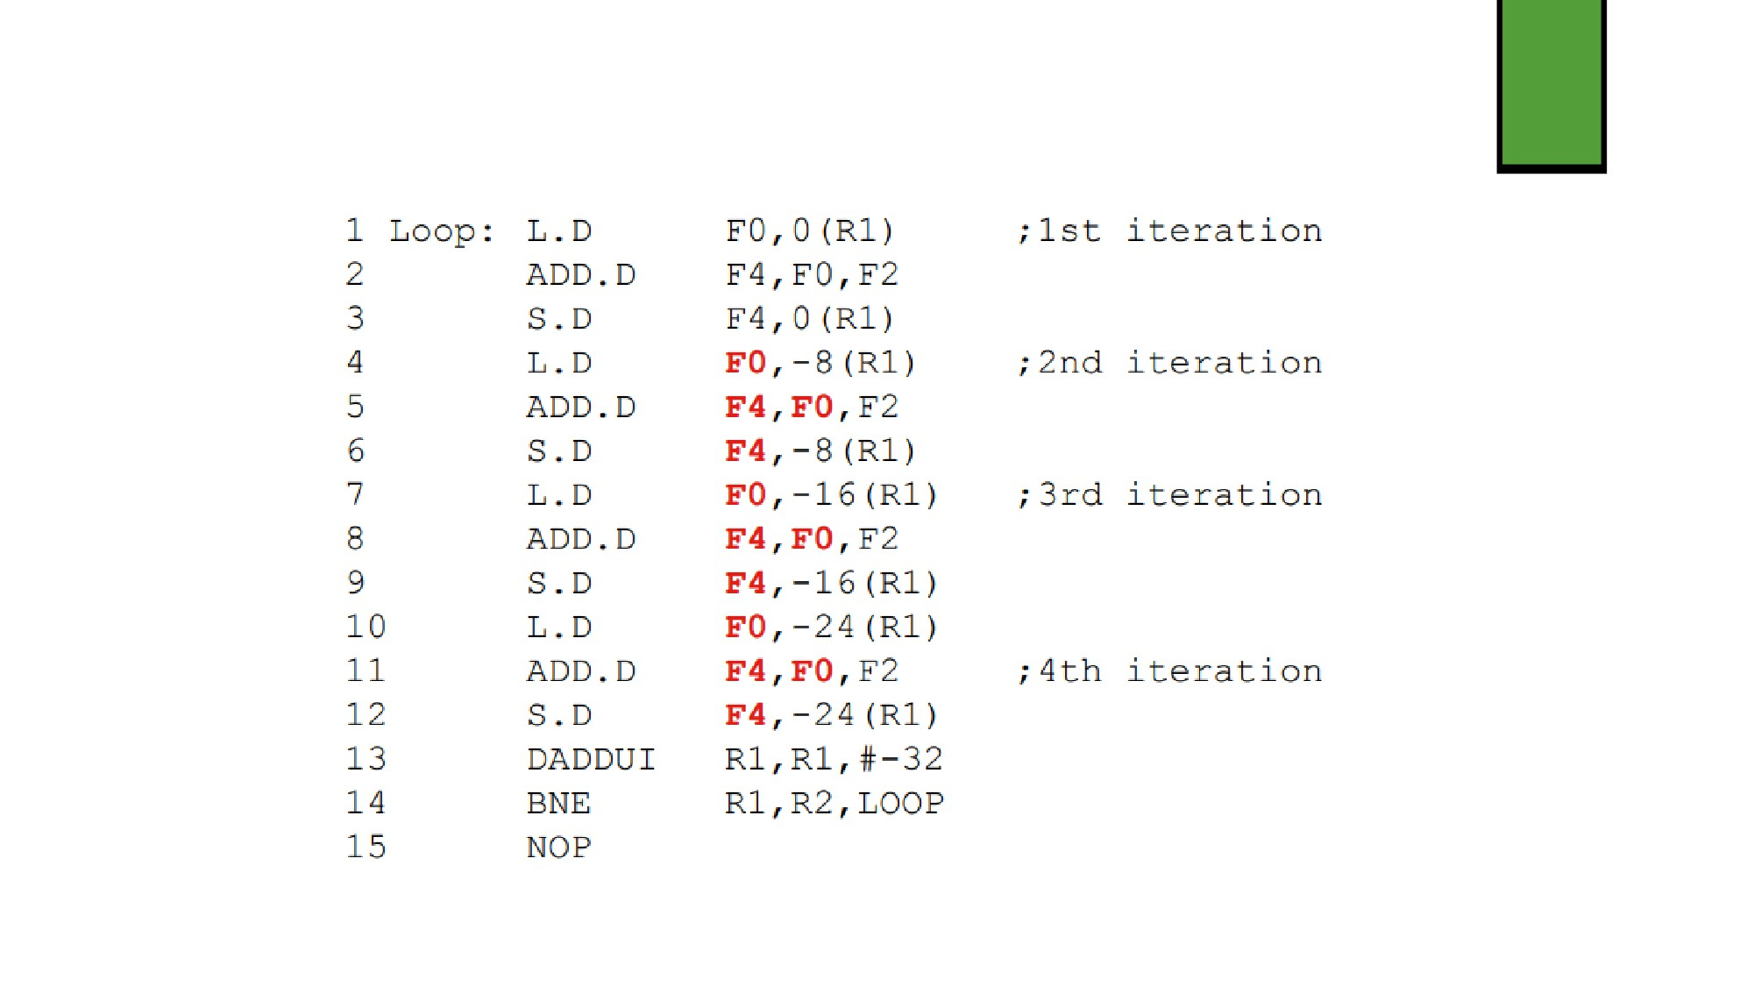
Second Step: Find Name Dependencies
9

Slide 9
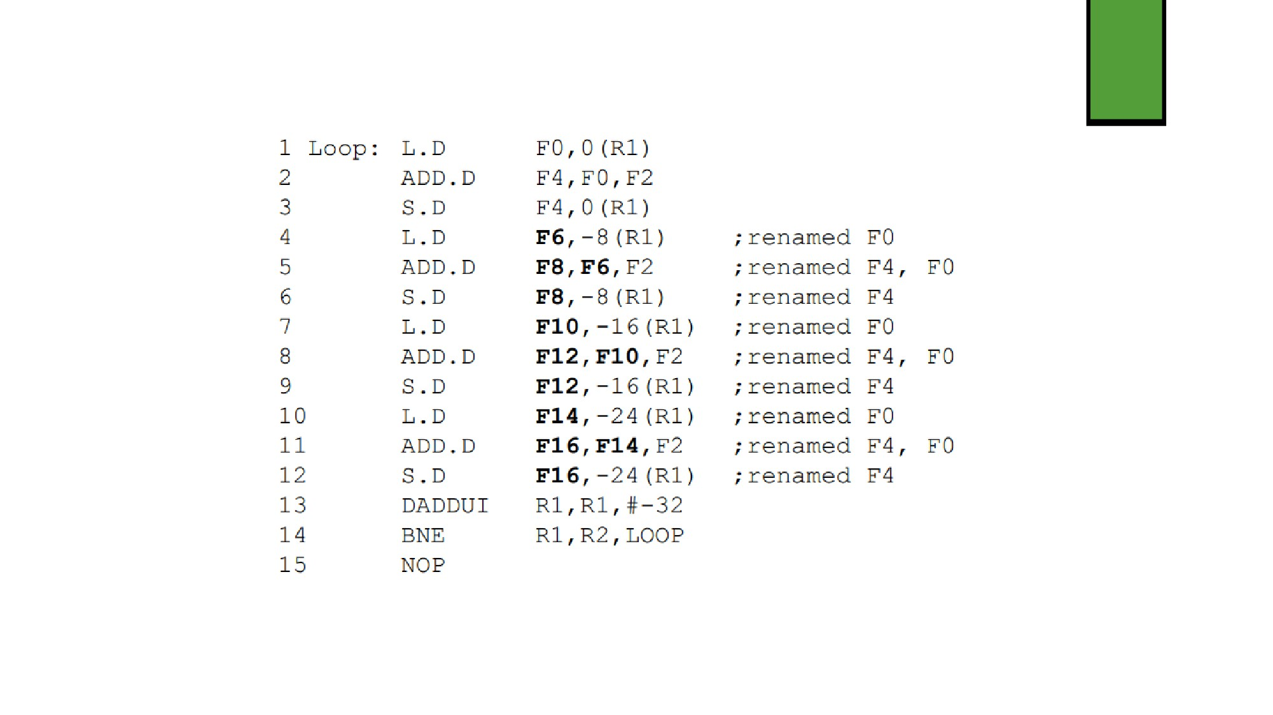
Third Step: Register Renaming
10

Slide 10
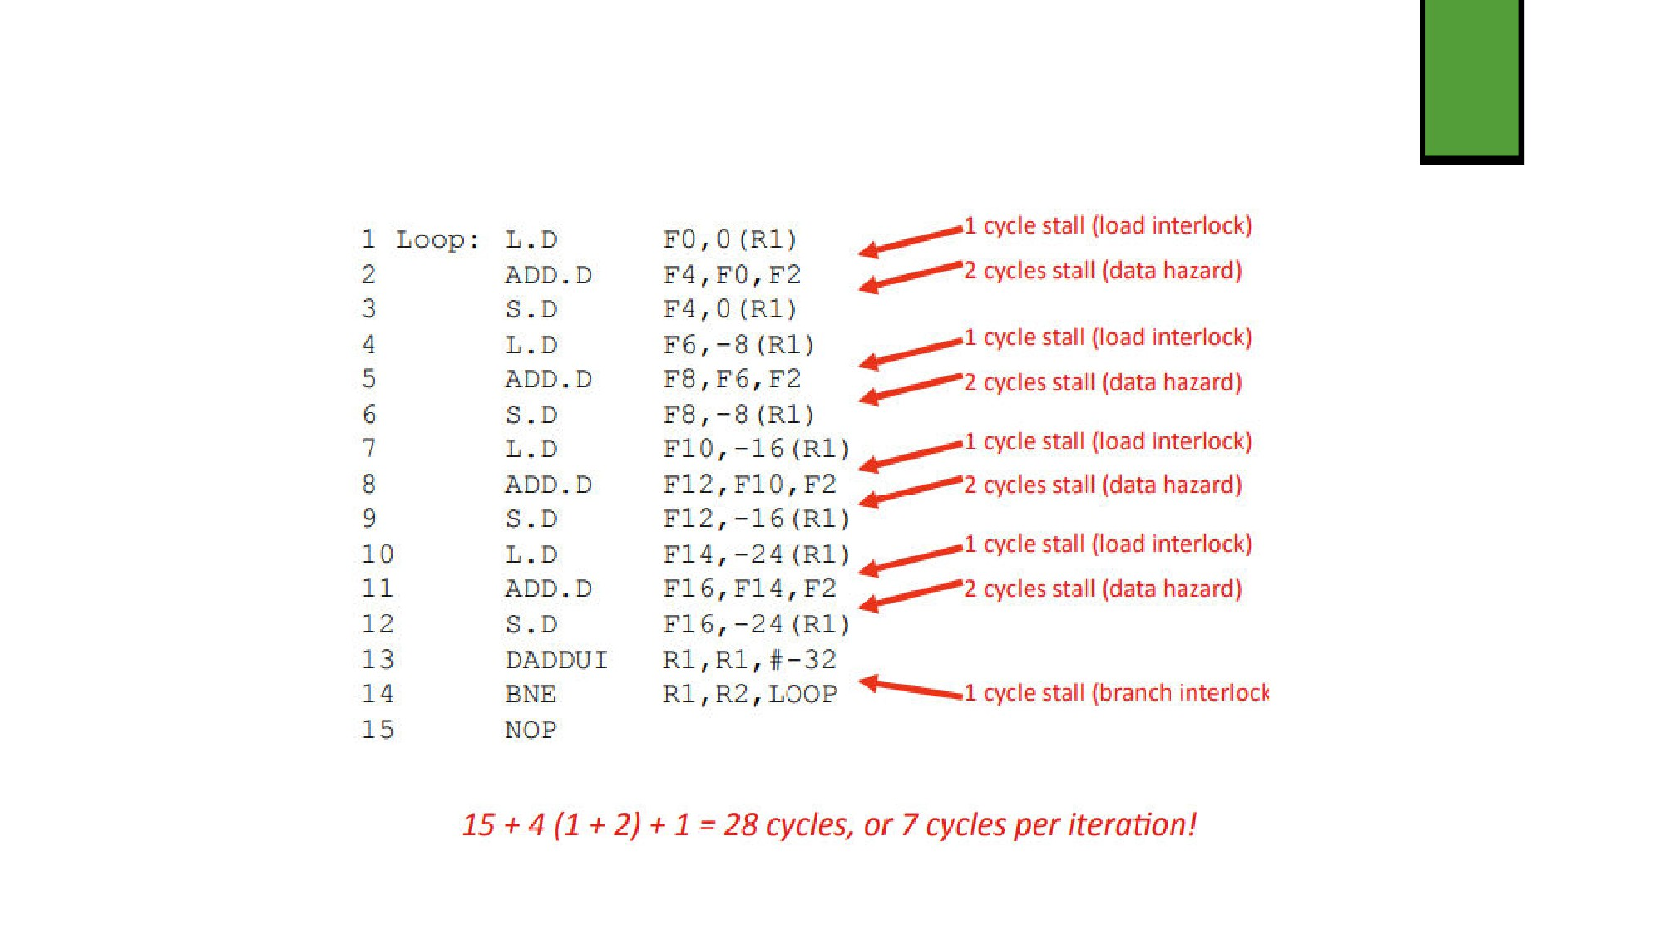
Unrolled: Unscheduled
11

Slide 11
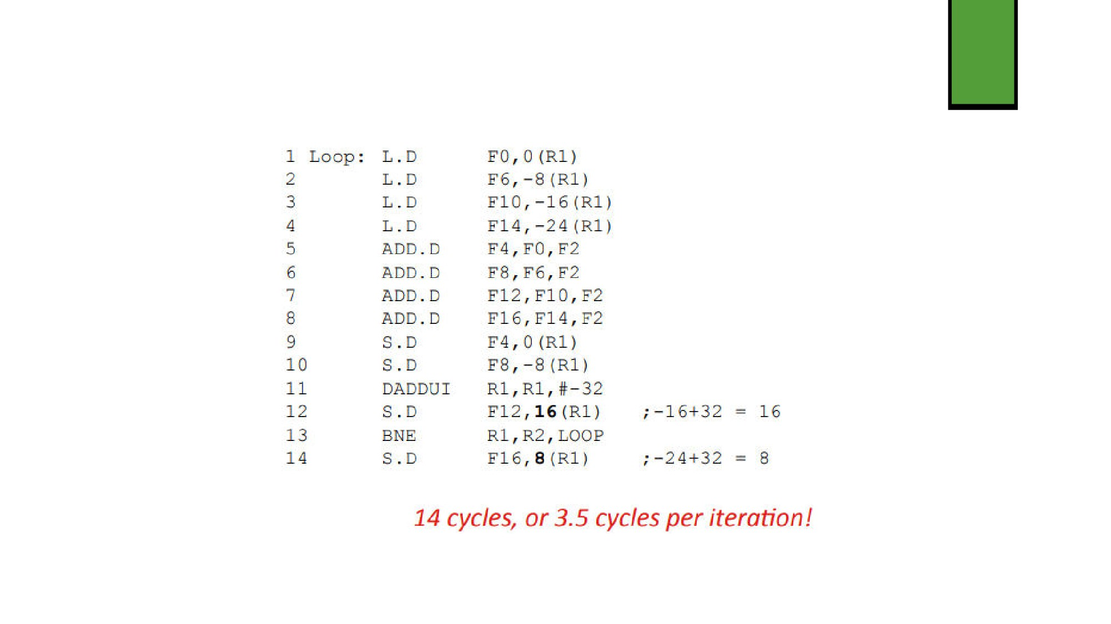
Unrolled: Scheduled
12

Slide 12
13
Loop Unrolling is not Free
◆ Benefits decrease with additional unrolling
◆ Code length increases with additional unrolling
◆ This is issue for embedded processors
◆ This can increase instruction cache miss rates  Uses lots of registers
◆ Renaming requires many registers
◆ When registers become scarce: “register pressure”
◆ Aggressive unrolling and scheduling and cause a compiler to run out of registers to use for renaming.

Slide 13
14
Compiler’s Perspective: Unrolling Loops
◆ We don’t usually know the upper bound of a loop  Suppose it is n, and we want k copies of the loop  Don’t generate a single unrolled loop!  Generate a pair of consecutive loops:
◆ First executes the original loop (n mod k) times
◆ Second executes the unrolled loop body (n/k) times  For large n, most iterations occur in unrolled loop

Slide 14
15
Compiler Perspectives: Dependencies
◆ Compilers must preserve data dependencies
◆ Determine if loop iterations are independent
◆ Rename registers during unrolling
◆ Eliminate extra test and branch instructions
◆ Adjust loop maintenance and termination accordingly  Determine if loads and stores can be interchanged  Schedule the code, preserving dependencies

Slide 15
16
Compiler Perspectives: Renaming
◆ Dependent instructions can’t execute in parallel
◆ Easy to determine for registers (fixed names)  Much harder for memory
◆ This is the “memory disambiguation” problem  Does 100(R4) = 20(R6)?
◆ In different loop iterations, does 20(R6) = 20(R6)?
◆ In our example, compiler must determine that if R1 doesn’t change then: 0(R1) ≠ -8(R1) ≠ -16(R1) ≠ -24(R1)
◆ In this case, loads and stores can be interchanged

Slide 16
17
Loop Unrolling Summary
◆ Loop unrolling is a simple but useful method for increasing the size of straight-line code fragments that can be scheduled effectively.
◆ Looping Unrolling
◆ Reduces loop overhead
◆ Exposes additional instructions for scheduling  Compiler unrolls a loop by:
◆ Copying the loop
◆ Identifying and resolving name dependencies  Scheduling the loop
◆ Compiler must identify and preserve true data dependencies

Slide 17
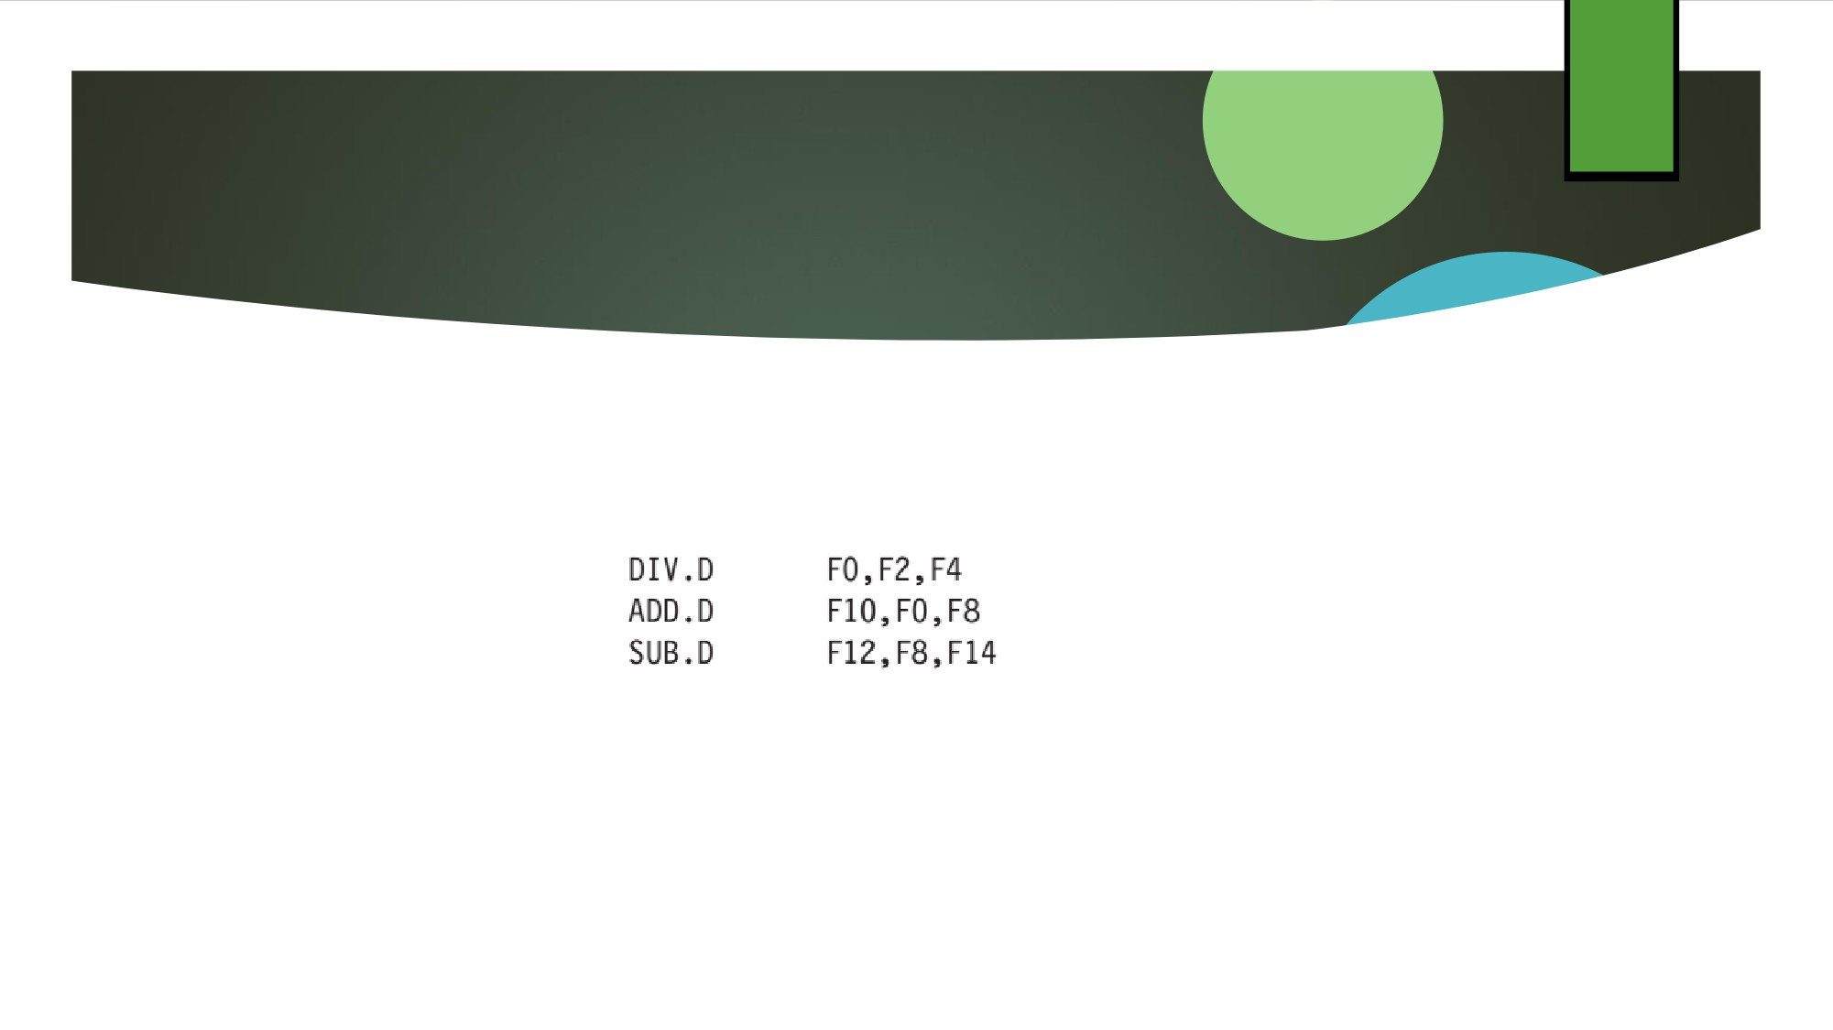
18
3.4 Overcoming Data Hazards by Dynamic Scheduling
◆ With dynamic scheduling, the hardware rearranges the instruction execution to reduce the stalls while maintaining data flow and exception behavior.
◆ In the classic five-stage pipeline, both structural and data hazards could be checked during instruction decode (ID):
◆ When an instruction could execute without hazards, it was issued from ID knowing that all data hazards had been resolved.

